Slide 1

Presentation on java 8 new features
Prepared By : Mayank Jain

Slide 2
Content
Lambda Expression
Functional Interfaces
Default methods
Predicates
Functions
Double colon operator (::)
Stream API
Date and Time API

Slide 3
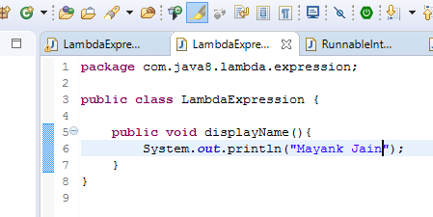

What is lambda expression?
Lambda Expression is just an anonymous (nameless) function.
Notes:
The function which doesn’t have the name, return type and access modifiers.
Also known as anonymous functions or closures.

Slide 4
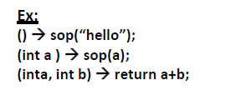
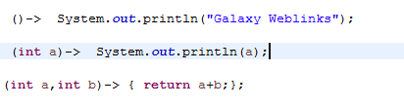
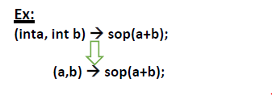
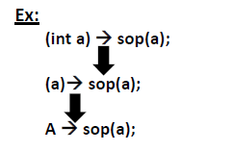
Characteristic or properties of lambda expression?
zero or more number of parameters (arguments).
Expects the type based on the context
Notes:
Usually we can specify type of parameter. If the compiler expects the type based on the context then we can remove type also.

Slide 5
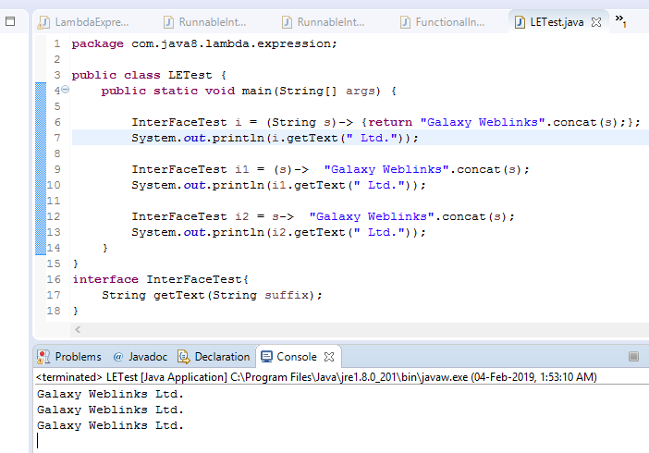
Characteristic or properties of lambda expression?
Notes:
Usually we can specify type of parameter. If the compiler expects the type based on the context then we can remove type also.

Slide 6
Characteristic or properties of lambda expression?
Separated with comma (,).
Body also can contain multiple statements.
Can remove return keyword.
Notes:
If multiple parameters present then these parameters should be separated with comma (,).
Similar to method body lambda expression body also can contain multiple statements. If more than one statements present then we have to enclose inside within curly braces. If one statement present then curly braces are optional.
If lambda expression return something then we can remove return keyword also.
If zero number of parameters available then we have to use empty parameter [ like ()].

Slide 7
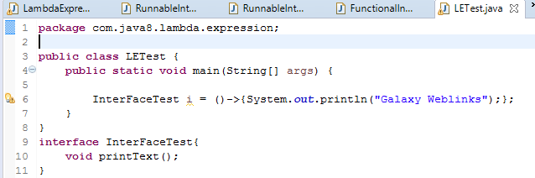
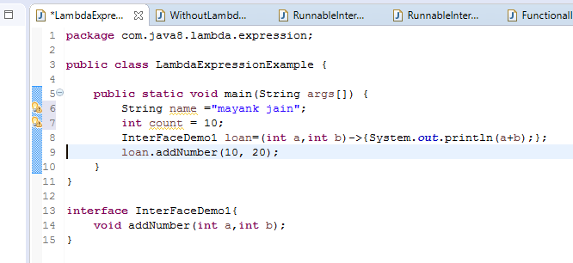
Characteristic or properties of lambda expression?
Empty parameter [ like ()].
Act as a type parameter.
Notes:
If multiple parameters present then these parameters should be separated with comma (,).
Similar to method body lambda expression body also can contain multiple statements. If more than one statements present then we have to enclose inside within curly braces. If one statement present then curly braces are optional.
If lambda expression return something then we can remove return keyword also.
If zero number of parameters available then we have to use empty parameter [ like ()].

Slide 8
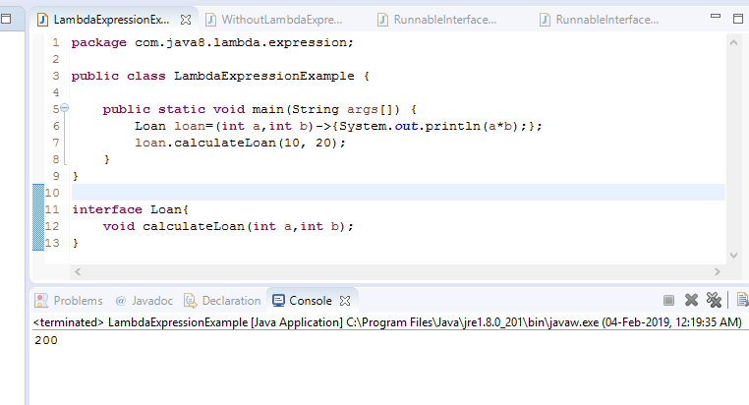
Functional Interface
Invoke Lambda Expression.
Notes:
Once we write lambda expression we can call that expression just like a method, for this functional interfaces are required.

Slide 9
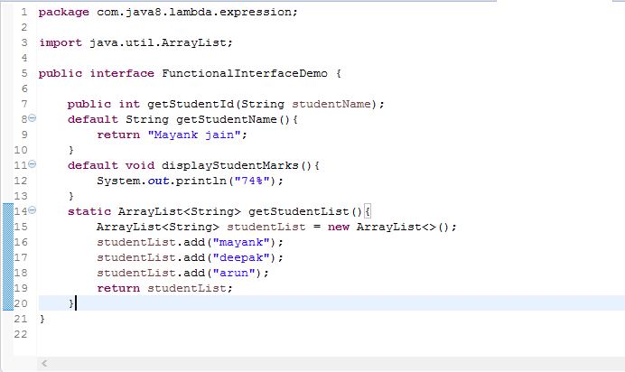
Characteristic or properties of Functional Interface
one abstract method.
any number of default and static methods.
Notes:
If an interface contain only one abstract method, such type of interfaces are called functional interfaces and the method is called functional method or single abstract method (SAM).
Inside functional interface in addition to single Abstract method (SAM) we write any number of default and static methods.

Slide 10
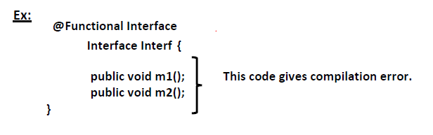
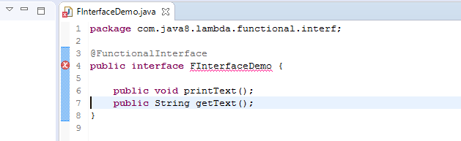

Characteristic or properties of Functional Interface
@FunctionalInterface annotation
Exactly one abstract method.
Notes:
In Java 8, Sun Micro System introduced @Functional Interface annotation to specify that the interface is Functional Interface.
Inside Functional Interface we can take only one abstract method, if we take more than one abstract method then compiler raise an error message that is called we will get compilation error.

Slide 11
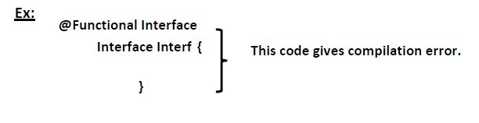
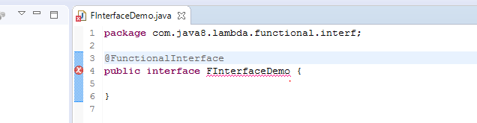
Characteristic or properties of Functional Interface
Notes:
In Java 8, Sun Micro System introduced @Functional Interface annotation to specify that the interface is Functional Interface.
Inside Functional Interface we can take only one abstract method, if we take more than one abstract method then compiler raise an error message that is called we will get compilation error.

Slide 12
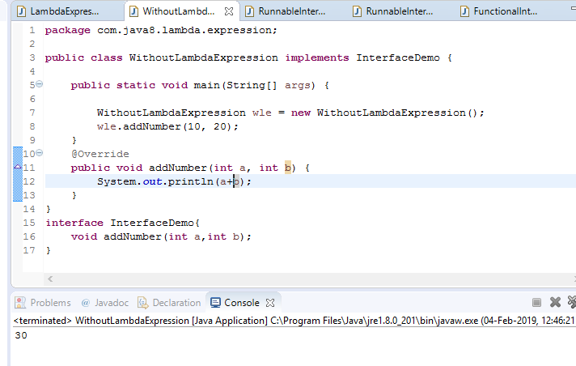
Functional Interface Example’s With Lambda Expression.
Without Lambda Expression (Add 2 Number’s).

Slide 13
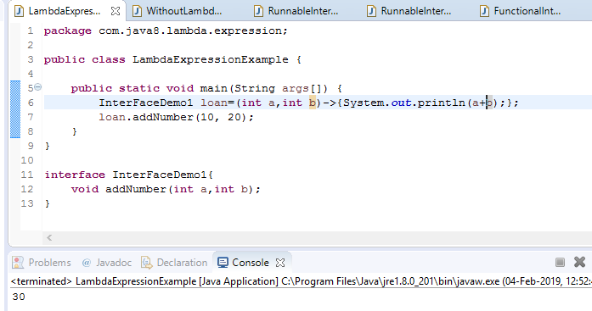
Functional Interface Example’s With Lambda Expression.
With Lambda Expression.

Slide 14
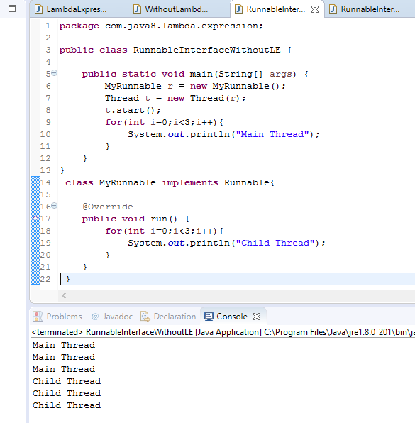
Functional Interface Example’s With Lambda Expression.
Without Lambda Expression (Thread concept).

Slide 15
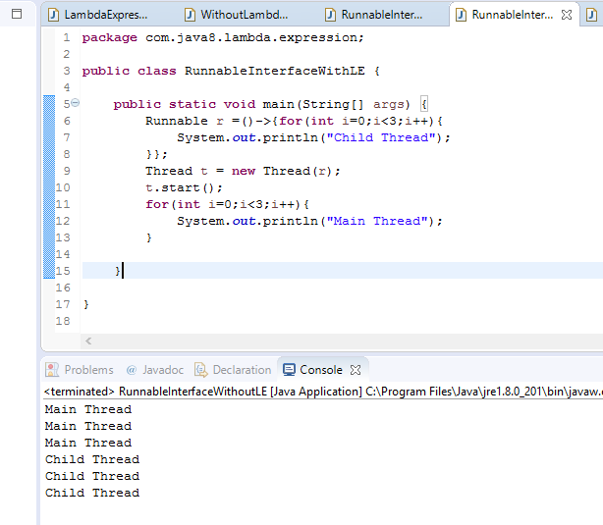
Functional Interface Example’s With Lambda Expression.
With Lambda Expression (Thread concept).

Slide 16
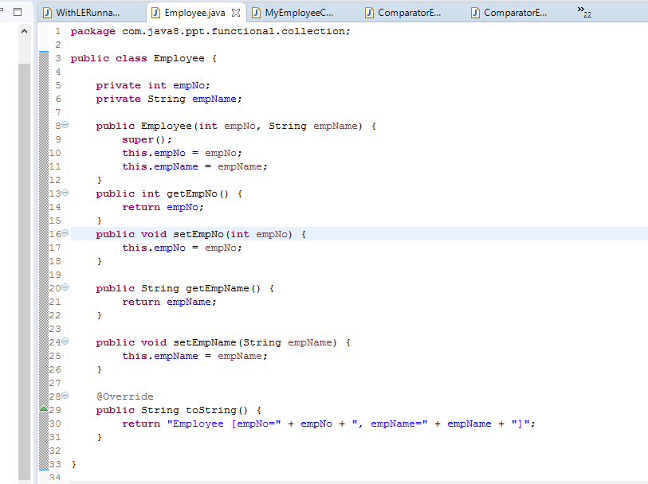
Functional Interface Example’s With Lambda Expression.
Without Lambda Expression (Comparator concept).

Slide 17
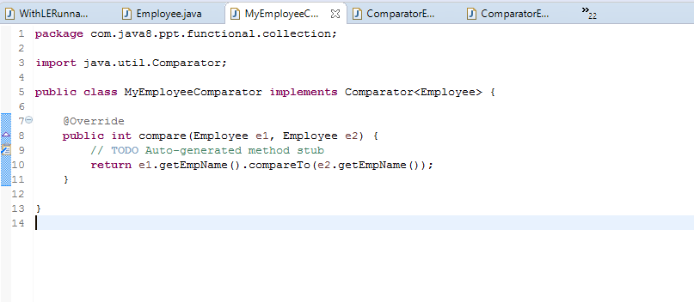
Functional Interface Example’s With Lambda Expression.

Slide 18
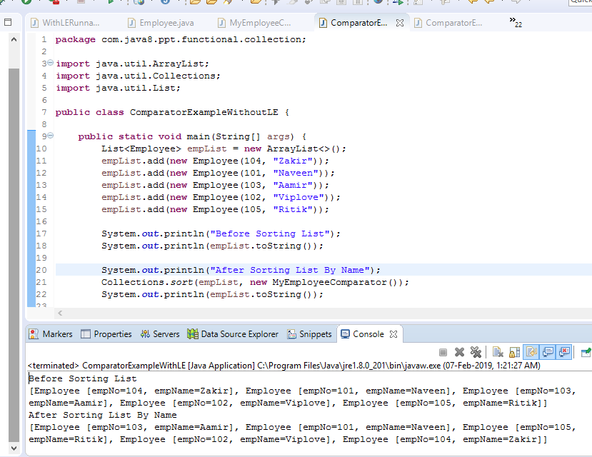
Functional Interface Example’s With Lambda Expression.

Slide 19
Functional Interface Example’s With Lambda Expression.
With Lambda Expression (Comparator concept).

Slide 20
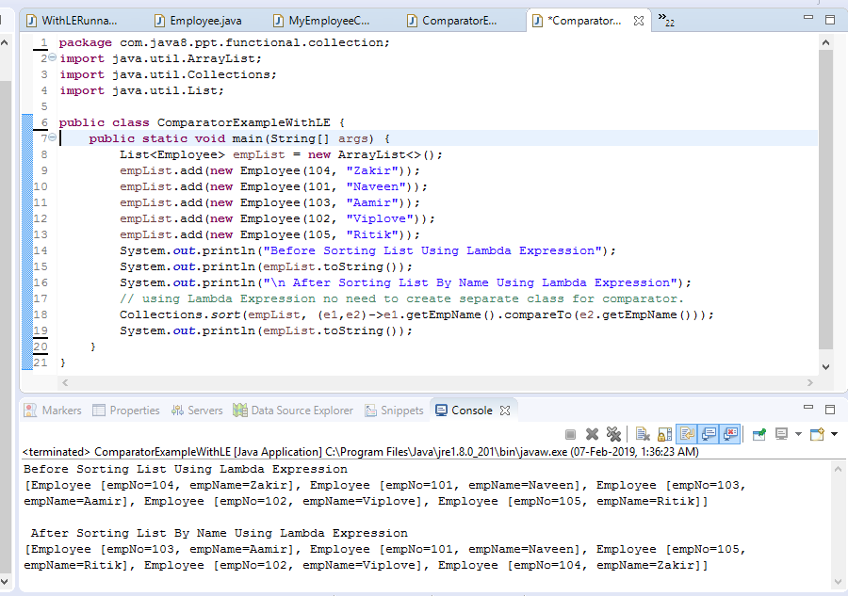
Functional Interface Example’s With Lambda Expression.

Slide 21
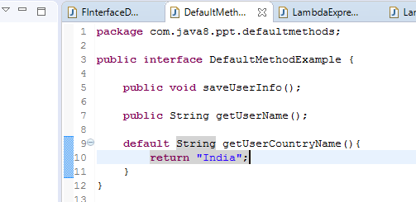
Default Methods.
Until java7 version.
But from 1.8 version onwards can declare default methods also.
“default” keyword.
Notes:
Default methods also known as defender methods or virtual extension methods.

Slide 22
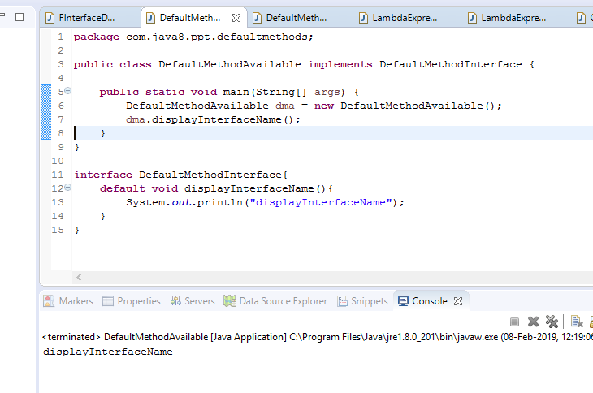
Default Methods.
add new methods to the already existing interface.
default methods are by-default available.
Notes:
To add new methods to the already existing interface , without affecting the implementation classes.
Interface default methods are by-default available to all implementation classes. Based on requirement implementation class can use these default methods directly or can override.

Slide 23
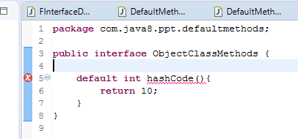
Default Methods.
can’t override object class methods as default methods.

Slide 24

Default Methods.
Notes:
Object class methods are by-default available to every Java class.hence it’s not required to bring through default methods.

Slide 25
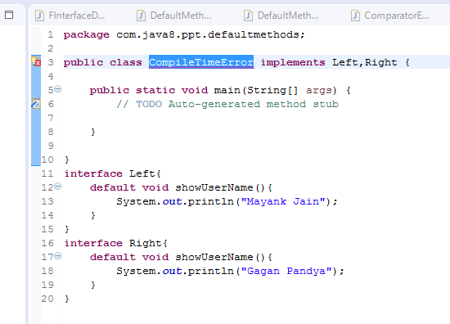
Default Methods.
Compile Time Error in case of multiple inheritance (ambiguity problem).
Notes:
Two interfaces can contain default method with same signature then there may be a chance of ambiguity problem (diamond problem) to the implementation class.
To overcome this problem compulsory we should override default method in the implementation class otherwise we get compile time error.

Slide 26
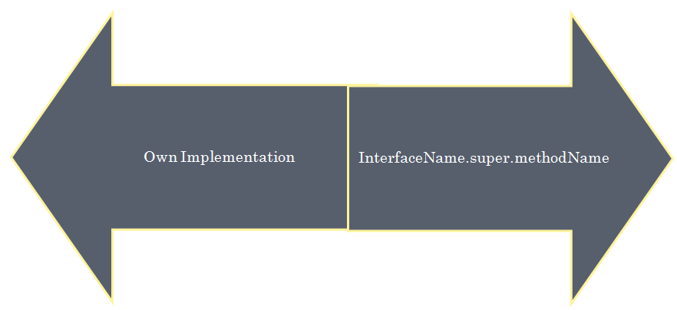
Default Methods.
Notes:
Two interfaces can contain default method with same signature then there may be a chance of ambiguity problem (diamond problem) to the implementation class.
To overcome this problem compulsory we should override default method in the implementation class otherwise we get compile time error.

Slide 27
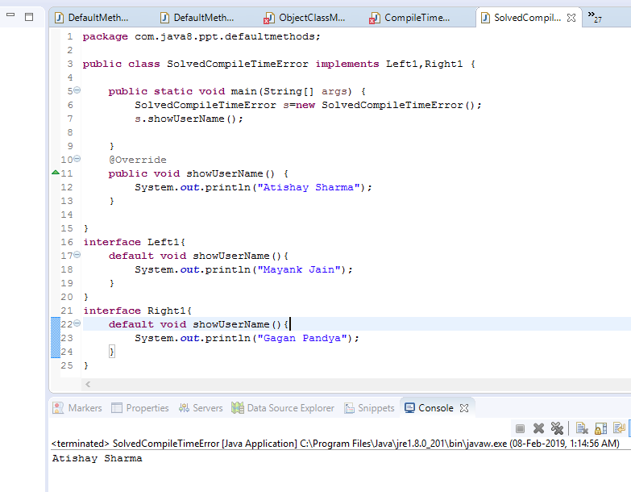
Default Methods.
Notes:
Two interfaces can contain default method with same signature then there may be a chance of ambiguity problem (diamond problem) to the implementation class.
To overcome this problem compulsory we should override default method in the implementation class otherwise we get compile time error.

Slide 28
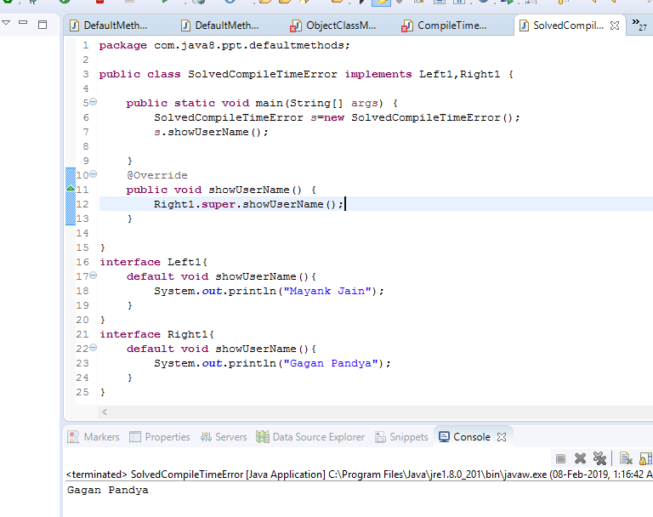
Default Methods.
Notes:
Two interfaces can contain default method with same signature then there may be a chance of ambiguity problem (diamond problem) to the implementation class.
To overcome this problem compulsory we should override default method in the implementation class otherwise we get compile time error.

Slide 29
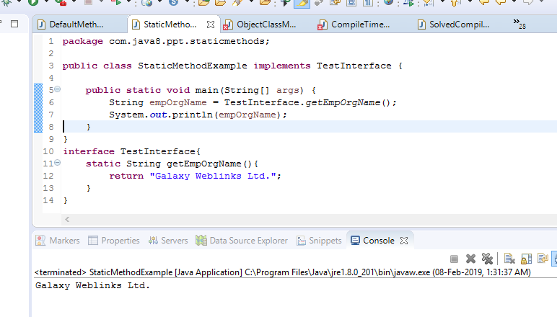
Static Methods.
From 1.8 version onwards can declare static methods also.
To define utility functions.
by-default not available to the implementation classes.
Notes:
From 1.8 version onwards in addition to default methods we can write static methods also inside interface to define utility functions.

Slide 30
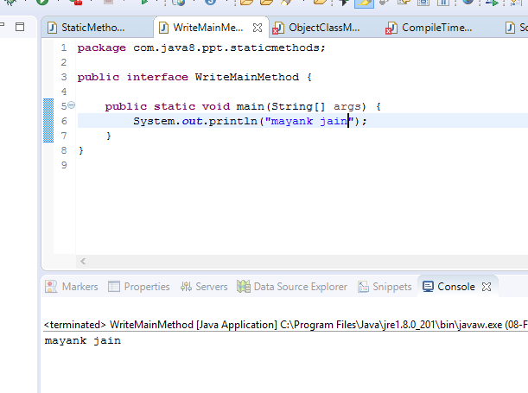
Static Methods.
write main() method inside interface.

Slide 31

Interface with default method ! = abstract class
Notes:
From 1.8 version onwards in addition to default methods we can write static methods also inside interface to define utility functions.

Slide 32
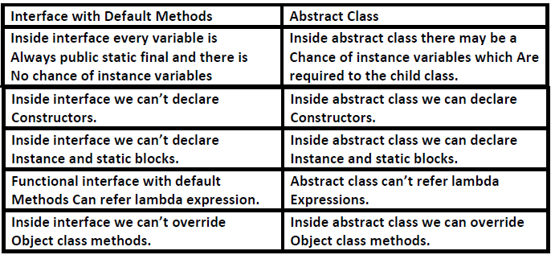

Slide 34
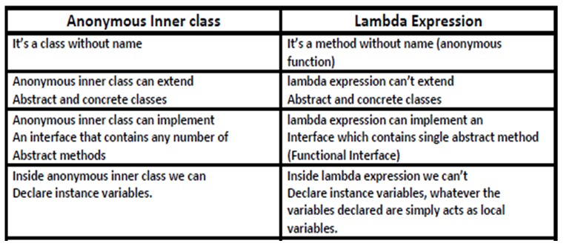

Slide 35
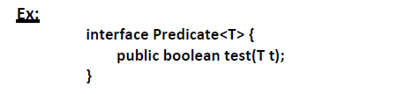
Predicate
With a single argument and returns boolean value.
present in Java.util.function package.
contains only one method.
Notes:
A predicate is a function with a single argument and returns boolean value.

Slide 36
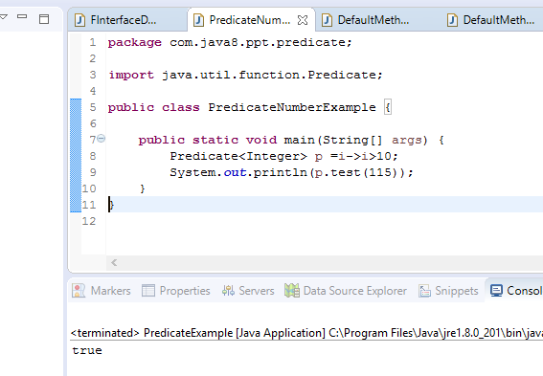
Predicate
Check any number is greater than 10 using predicate.
Notes:
A predicate is a function with a single argument and returns boolean value.

Slide 37
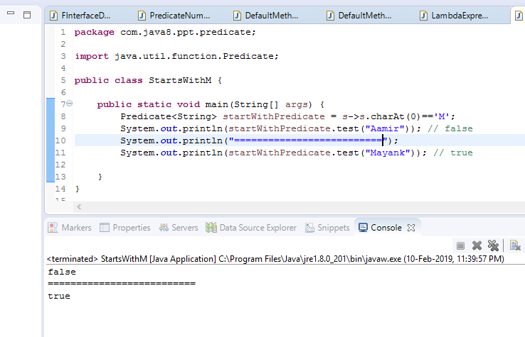
Predicate
Check any string starts with character ‘M’ or not using predicate.
Notes:
A predicate is a function with a single argument and returns boolean value.

Slide 38
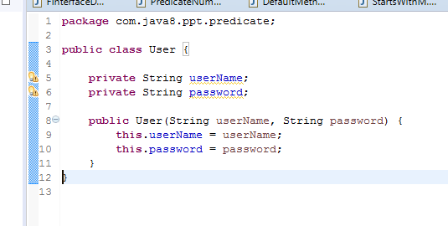
Predicate
Check user credential valid or not.
Notes:
A predicate is a function with a single argument and returns boolean value.

Slide 39
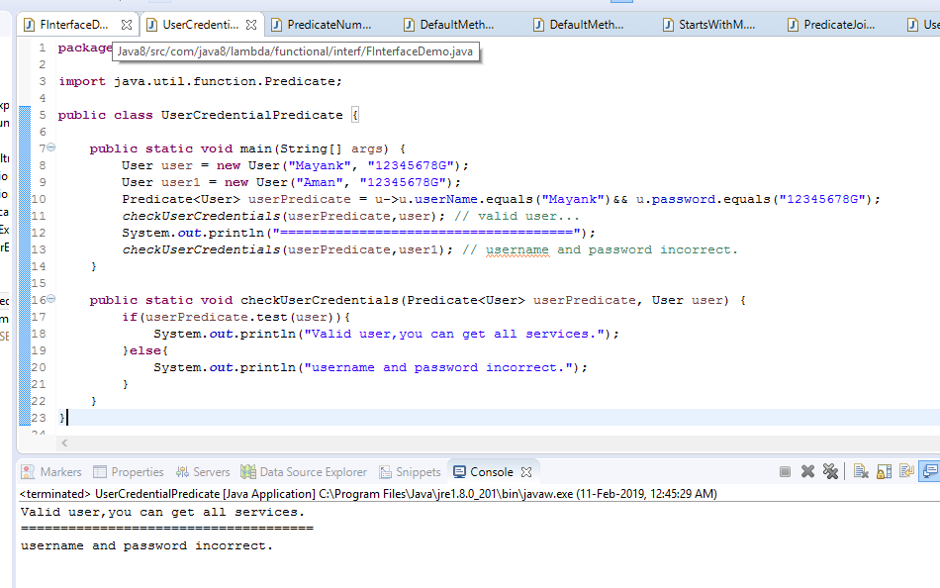
Predicate
Notes:
A predicate is a function with a single argument and returns boolean value.

Slide 40
Predicate Joining
It’s possible to join predicates into a single predicate.
and()
or()
negate()
exactly same as logical AND ,OR and complement operators.
Notes:
A predicate is a function with a single argument and returns boolean value.
exactly same as logical AND ,OR complement operators.

Slide 41
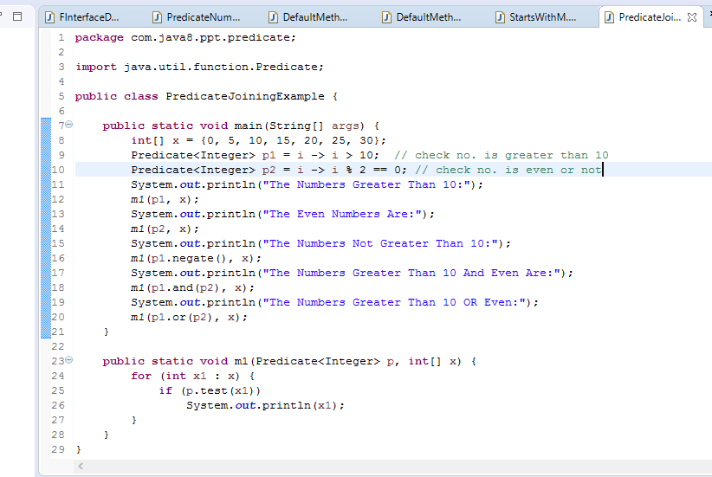
Predicate Joining
Notes:
A predicate is a function with a single argument and returns boolean value.
exactly same as logical AND ,OR complement operators.

Slide 42
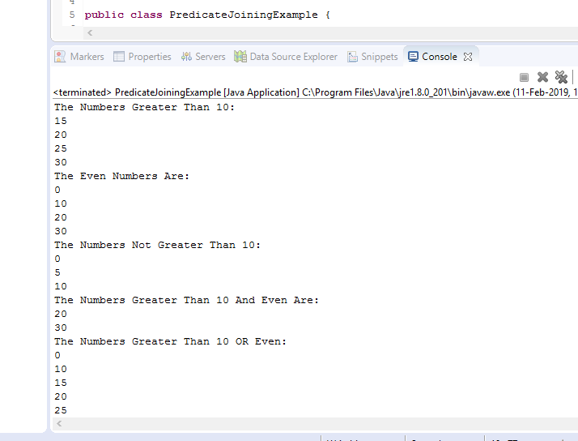
Predicate Joining
Notes:
A predicate is a function with a single argument and returns boolean value.
exactly same as logical AND ,OR complement operators.

Slide 43
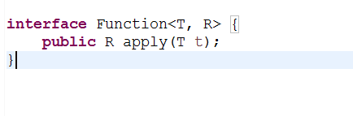
Function
Functions can return any type of result.
Present in Java.util.function package.
It is also a predefined functional interface.
contains only one method.
Notes:
Functions are exactly same as predicates except that functions can return any type of result but function should (can) return only one value and that value can be any type as per our requirement.
Function interface present in Java.util.function package.
contains only one method.

Slide 44
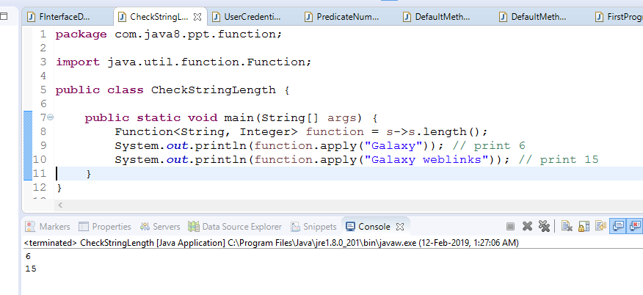
Function
Programme to find out length of String.

Slide 45
Difference B/W Predicate & Function

Slide 46
Predicate | Function
To implement conditional checks We should go for predicate. | To perform certain operation And to return some result we Should go for function.
Predicate can take one type Parameter which represents Input argument type. Predicate<T> | Function can take 2 type Parameters. First one represent Input argument type and Second one represent return Type. Function<T,R>
Predicate can return only boolean value. | Function can return any type of value.

Slide 47
Stream Api
Process objects of the collection.
Present in java.util package.
Stream is an interface.
We can process the objects in the following 2 phases.
Configuration .
Processing .
Notes:
To process objects of the collection, in 1.8 version Streams concept introduced.
Stream is an interface.

Slide 48
Configuration
Filter mechanism or Map mechanism.
Filter Mechanism :
Map Mechanism :
Notes:
We can configure either by using filter mechanism or by using map mechanism.

Slide 49
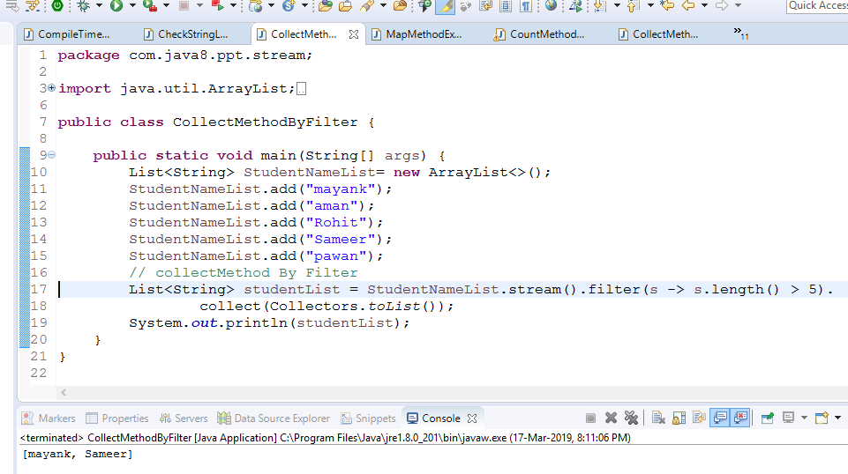
Processing
Processing By collect() method
Collects the element from the stream .
Adding to the specified Collection.
Notes:
This method collects the element from the Stream and adding to the specified Collection.

Slide 50
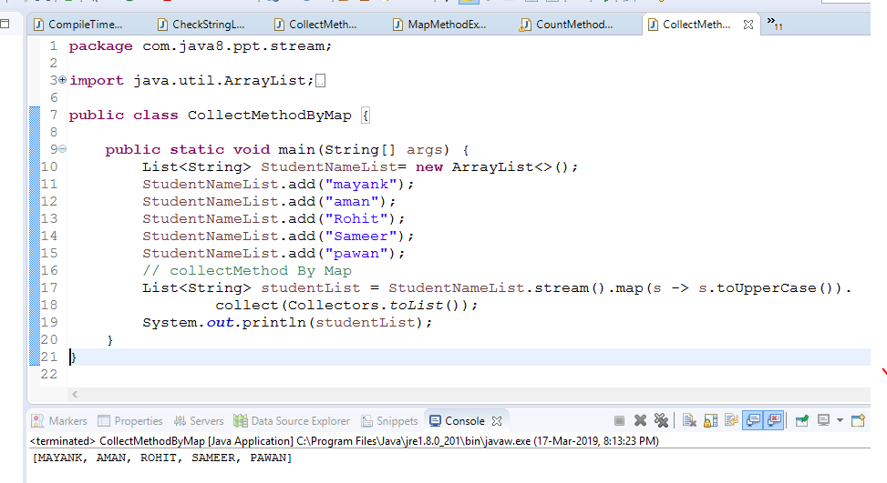
Processing
Processing By collect() method
Notes:
This method collects the element from the Stream and adding to the specified Collection.

Slide 51
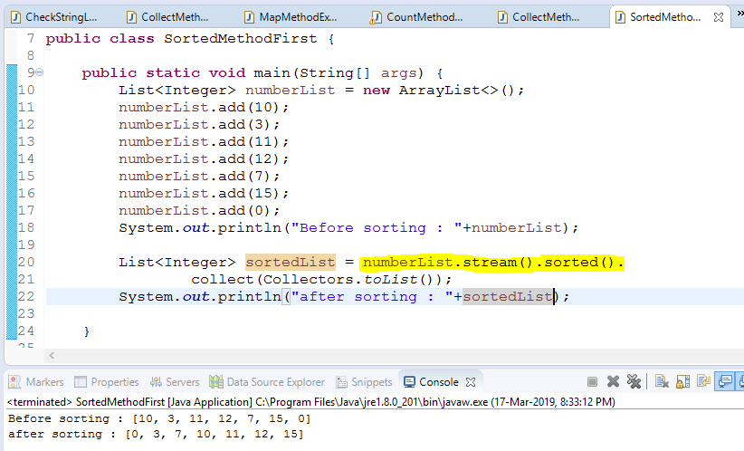
Processing
Processing By sorted() method
Sort elements present inside stream.
We can apply sorting using 2 ways.
sorted() : Default natural sorting
Notes:
This method return the number of element present in stream.
sorted(Comparator c) : customized sorting
.

Slide 52
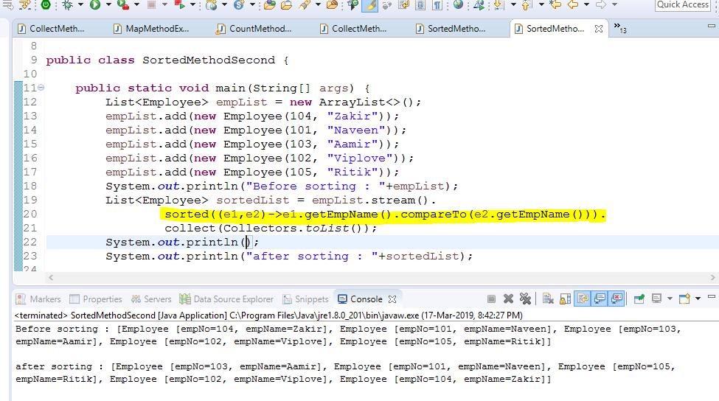
Processing
Processing By sorted() method
sorted(Comparator c) : customized sorting
Notes:
This method return the number of element present in stream.
sorted(Comparator c) : customized sorting

Slide 53
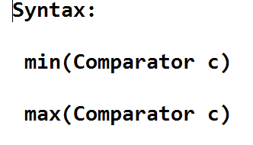
Processing
Processing By min() & max() method
Return minimum and maximum value.
Notes:
Return minimum and maximum value according to specified comparator.

Slide 54
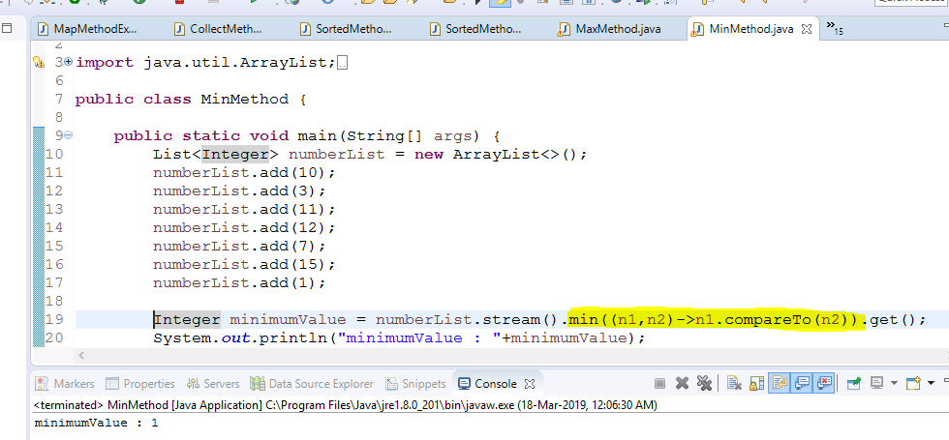
Processing
Processing By min() & max() method
Notes:
Return minimum and maximum value according to specified comparator.

Slide 55
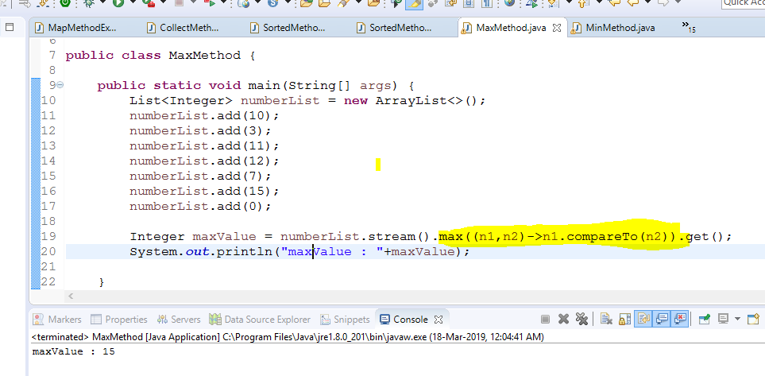
Processing
Processing By min() & max() method
Notes:
Return minimum and maximum value according to specified comparator.

Slide 56
Processing
Processing By forEach() method
Won’t return anything.
Take lambda exp as argument.
Apply that exp to each element present inside stream.
Notes:
This method Won’t return anything.
It take lambda exp as argument and apply that exp to each element present inside stream.

Slide 57
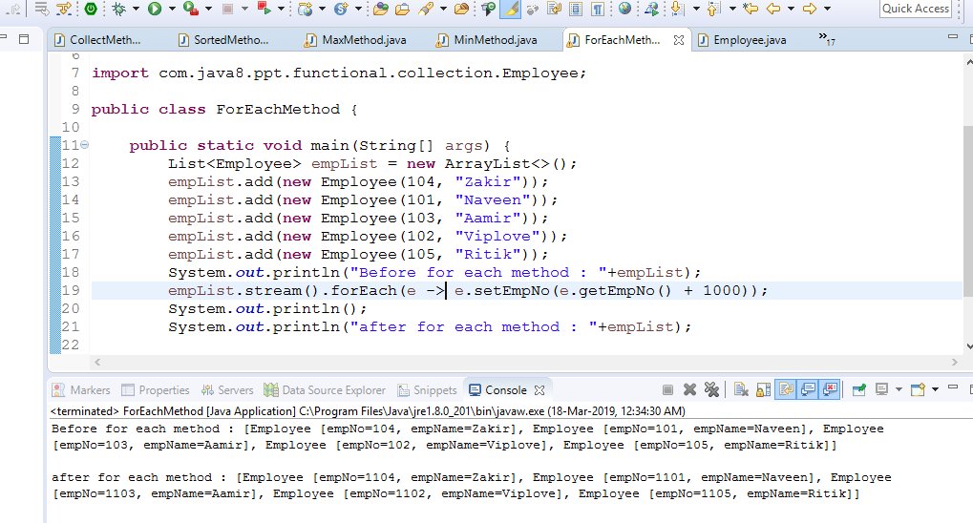
Processing
Processing By forEach() method
Notes:
This method Won’t return anything.
It take lambda exp as argument and apply that exp to each element present inside stream.

Slide 58


